Slide 1

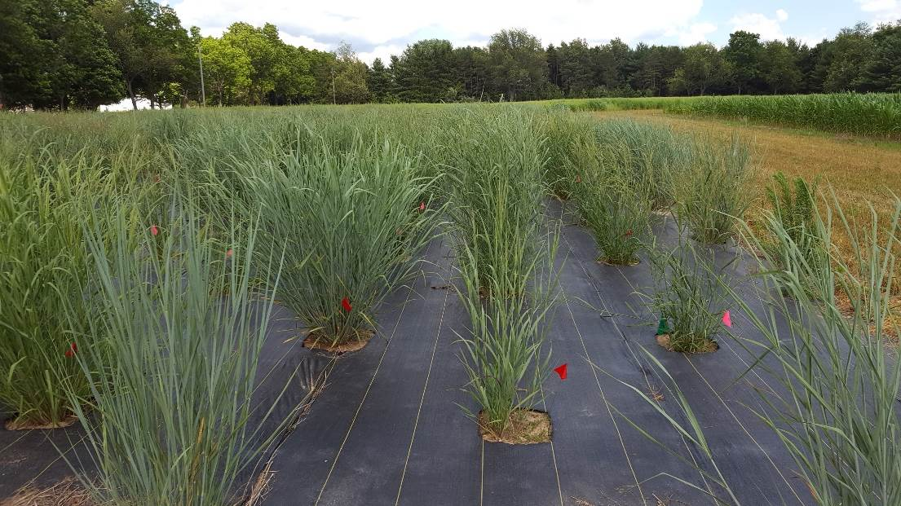

Genetics of Genotype-By-Environment Interactions in the Switchgrass Diversity Panel
Alice MacQueen
BER Plant Genomic Science Workshop
2020-01-13

Slide 2
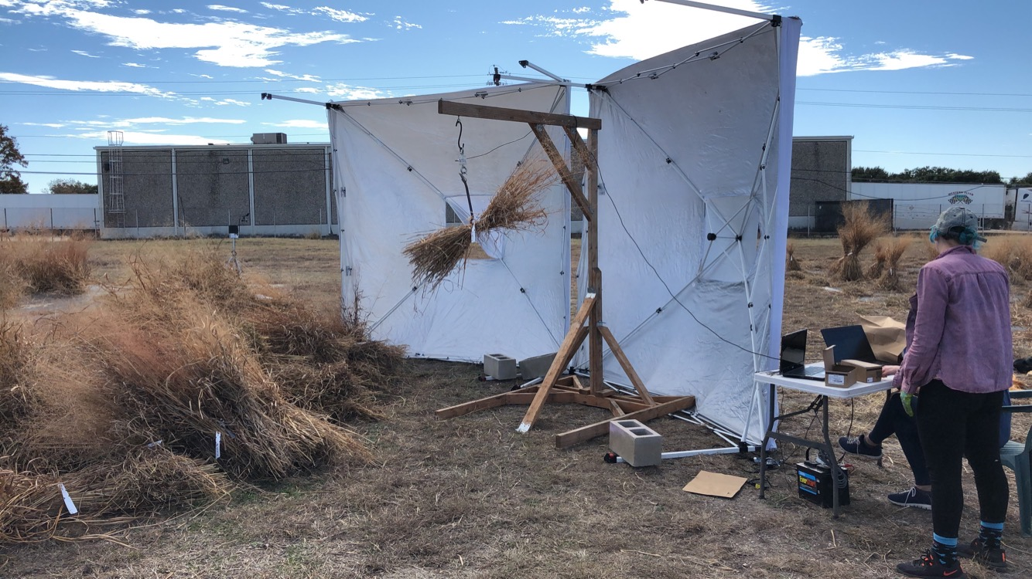

Slide 3
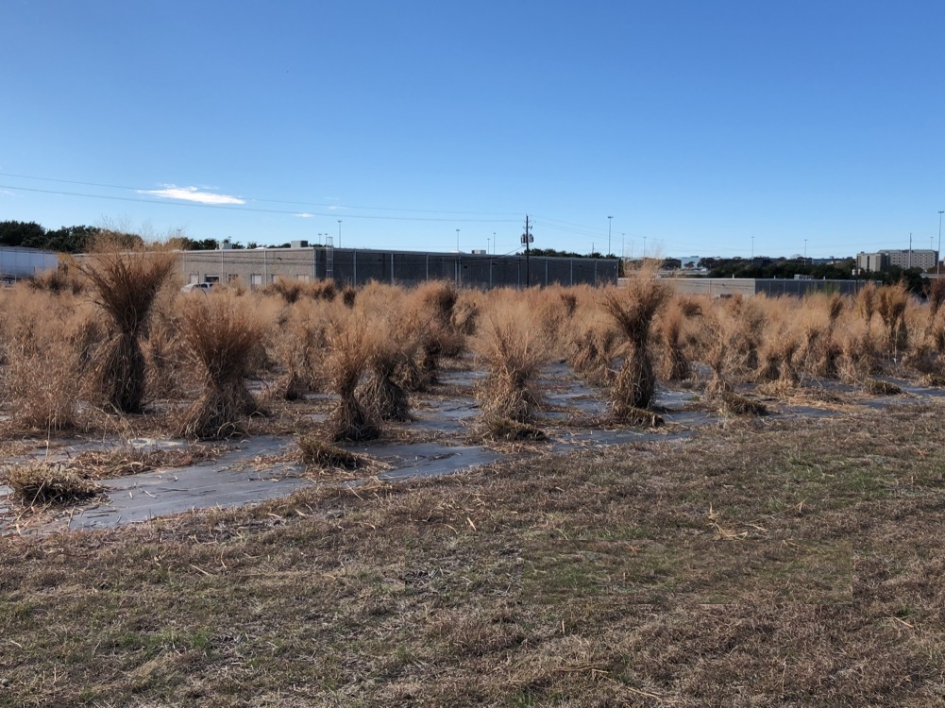

Slide 4
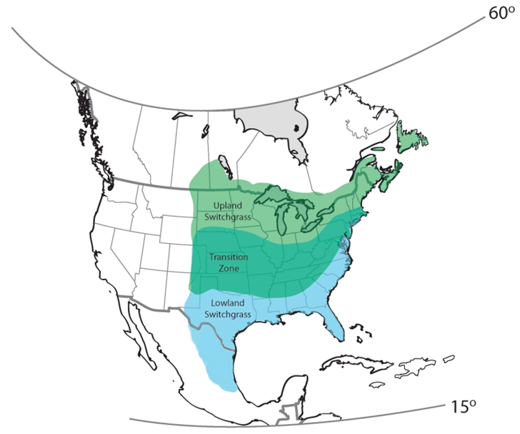
Switchgrass (Panicum virgatum)
Native to North America
Widespread distribution/habitats
C4 perennial
Lowland/upland ecotypes
Polyploidy (tetraploid/octoploid)
Outcrossing/wind pollinated
Long history of agronomic work
Productive on marginal lands
High yielding (7-10 tons/acre)
DOE JGI efforts

Slide 5
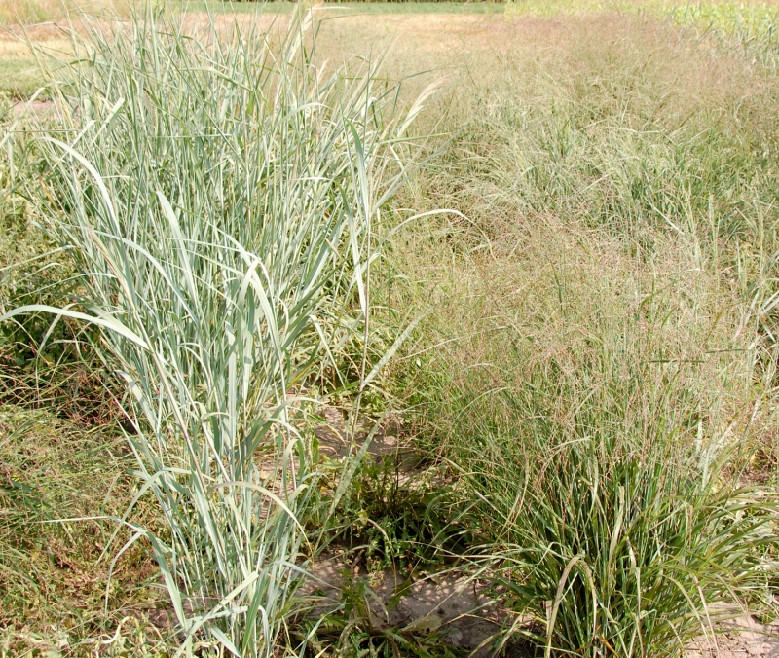
Switchgrass (Panicum virgatum)
lowland
upland
Native to North America
Widespread distribution
C4 perennial
Lowland/upland ecotypes
Allopolyploid (4x & 8x)
Outcrossing/wind pollinated
Long history of agronomic work
Productive on marginal lands
Potential biofuel feedstock
Casler et al. 2011
>3-4 myr divergence
ongoing hybridization

Slide 6
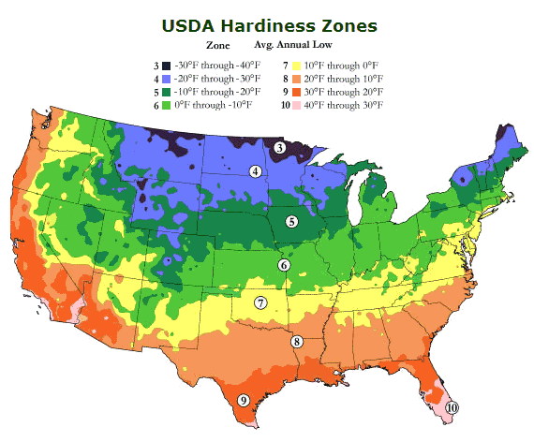
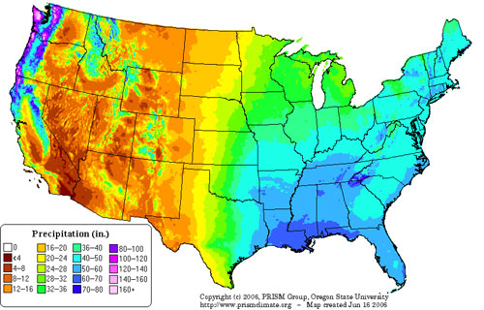
Remarkable Climatic Gradients:
~8 USDA Cold Hardiness Zones
>60 inches of Annual Precipitation

Slide 7
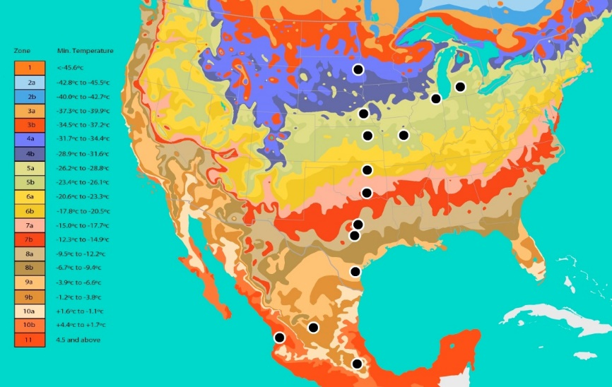
Common gardens to study adaptation:
QTL and GWAS panel planted across latitudinal gradient to detect genes involved in performance and stability
Collaborative and community building effort – including involvement of DOE JGI, DOE Bioenergy Centers, CIMMYT, Ladybird Johnson Wildflower Center and many others…..
16 planting locations
24.3 degrees of latitude!

Slide 8
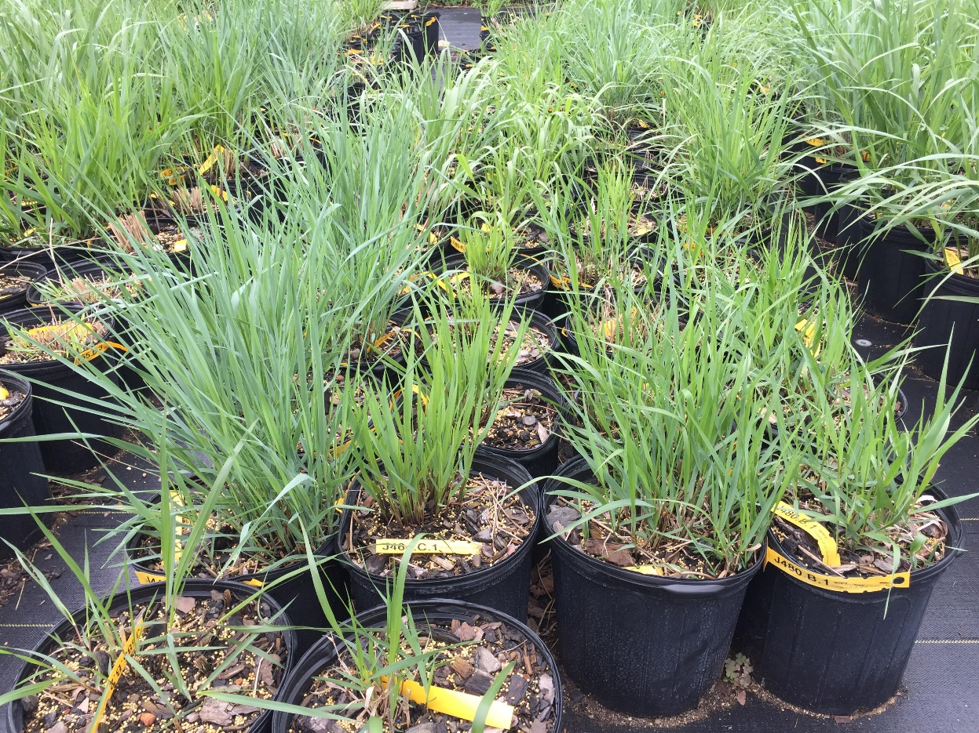
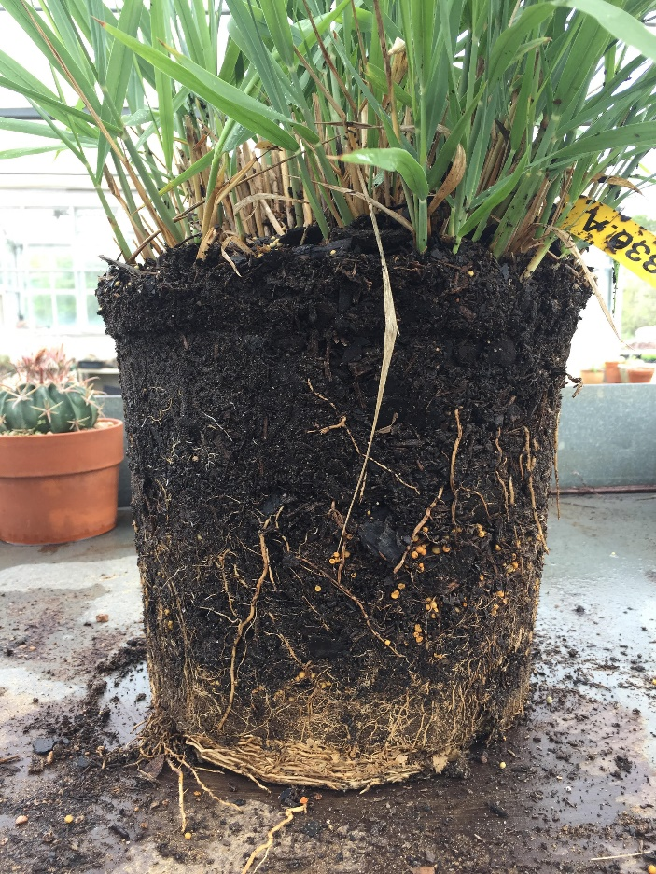

Slide 9
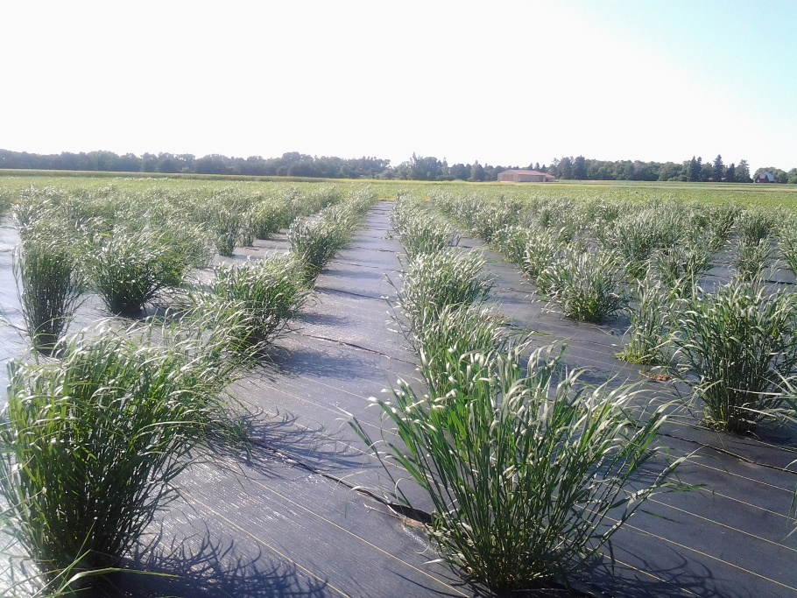
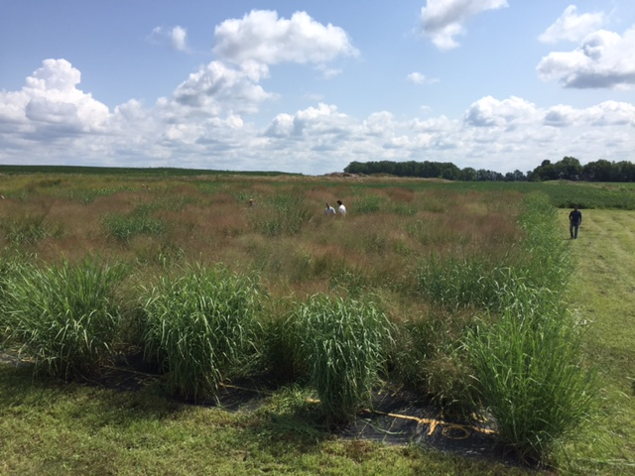
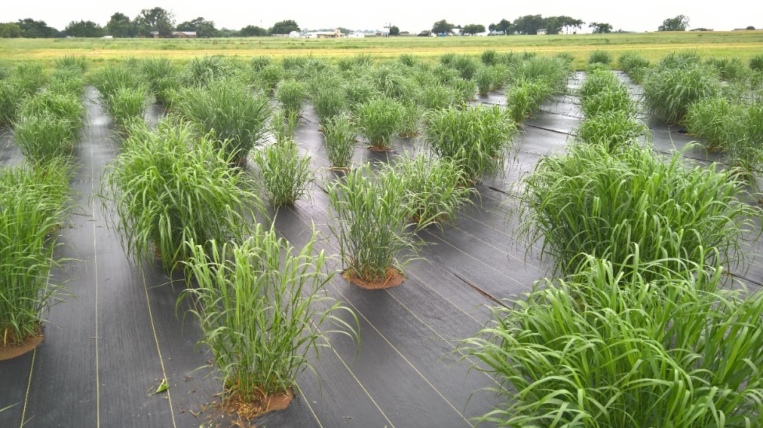

Slide 10
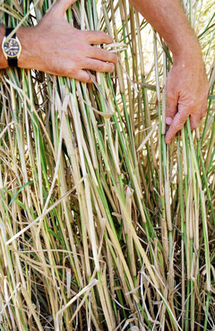
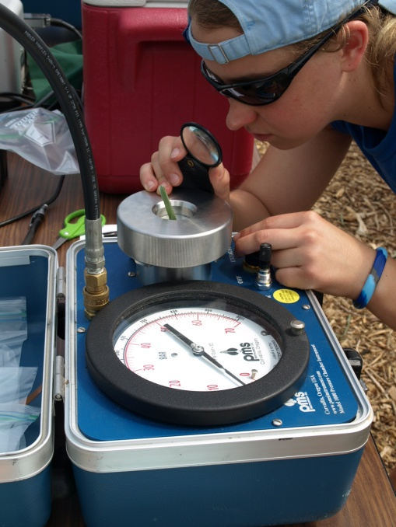
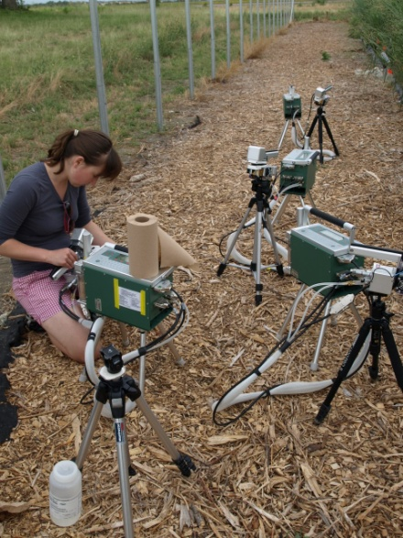
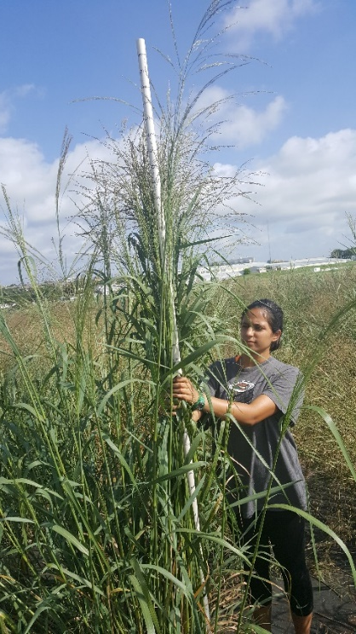
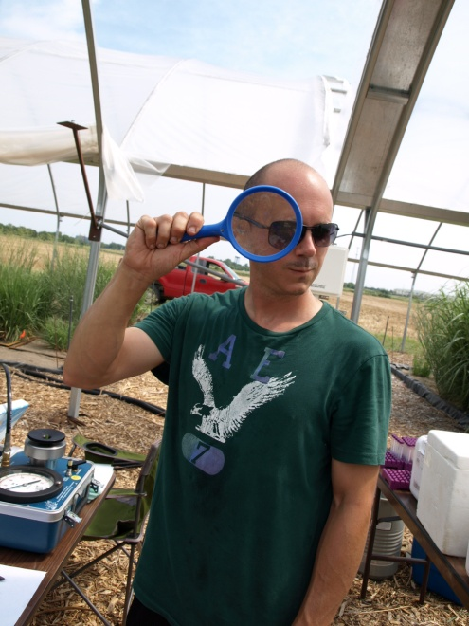
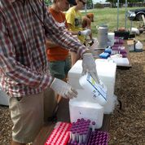
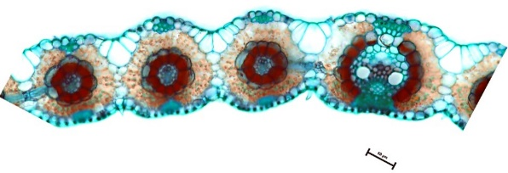
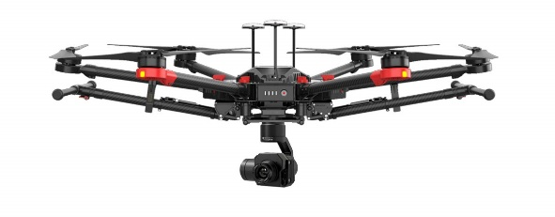

Slide 11
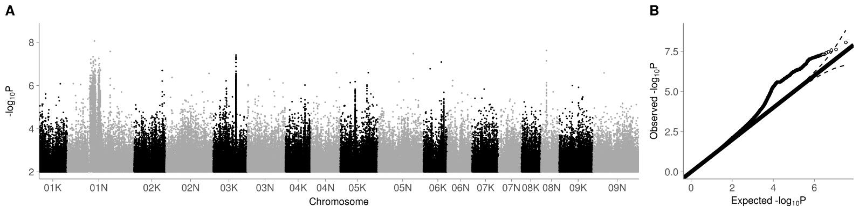
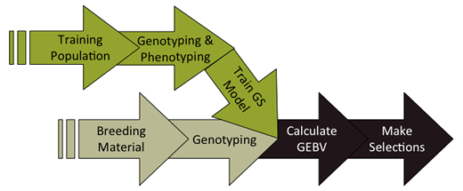
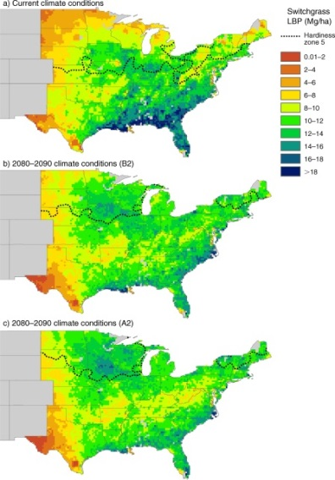
Association & Population Genomic Studies
Genomic Selection & Breeding
Climate Niche Characterization
Agronomic modeling

Slide 12

Is switchgrass locally adapted to climatic gradients? If so, at what spatial scales?
Which gradients are most important?
What are the mechanisms, traits, and genes important for current or future adaptation to climate?
How important are genetic tradeoffs in driving patterns of climate adaptation?

Slide 13
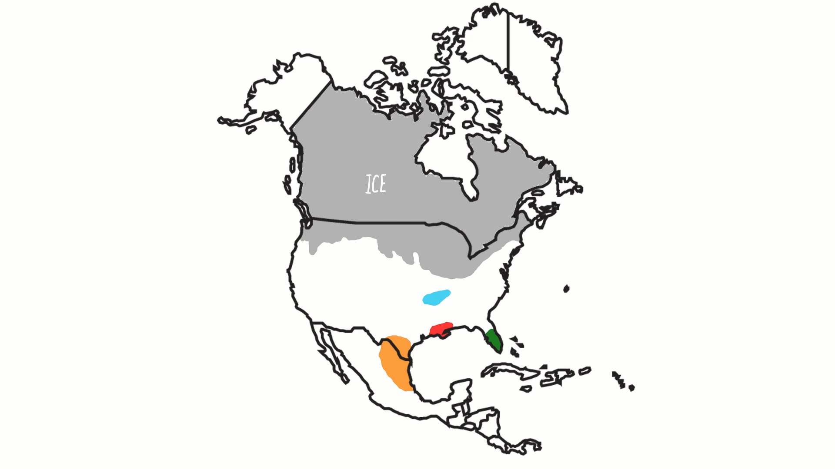
Dynamic Population History
Range expansion and colonization
Contraction to southern refugia

Slide 14
Switchgrass Natural History
Short growing seasons
Cold winters
Strong photoperiod & temperature signals
Range expansion and colonization
Long growing seasons
Mild winters
Variable precipitation
Contraction to southern refugia

Slide 15
Switchgrass Natural History
Short growing seasons
Cold winters
Strong photoperiod & temperature signals
Northern Uplands
Freezing tolerant
Short leaf/tiller lifespan
Pathogen/herbivore susceptible
Rhizomatous/spreading growth
Often octoploid 8x
Southern Lowlands
Freezing sensitive
Long leaf/tiller lifespan
Pathogen/herbivore resistant
Bunchgrass growth
Tetraploid 4x
Long growing seasons
Mild winters
Variable precipitation

Slide 16
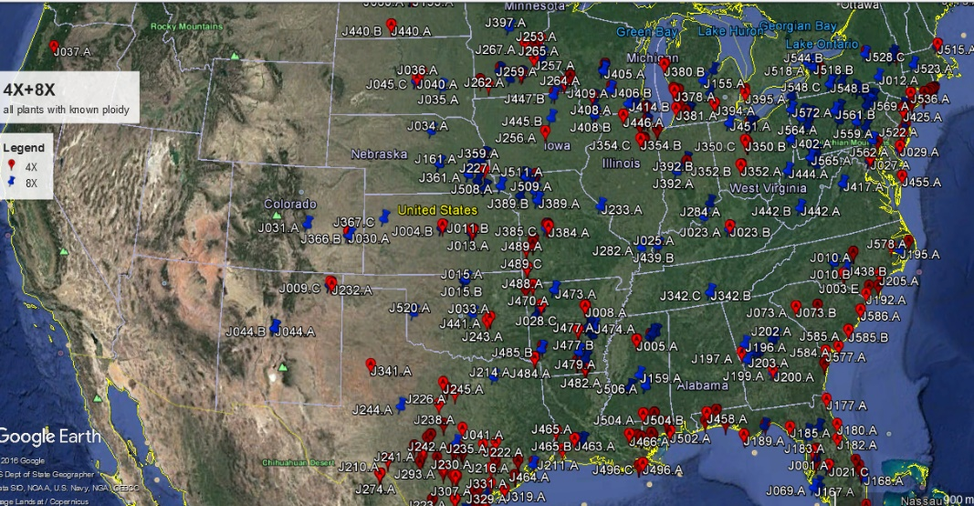
Gene x environment interactions and adaptation across climatic gradients:
Collection of native material across species range for development of a comprehensive diversity panel
QTL and GWAS panel planted across latitudinal gradient
16 locations, ~23˚ latitude
Planted in summer of 2018
Collaborative and community building effort – including involvement of JGI, DOE Bioenergy Centers, CIMMYT, Ladybird Johnson Wildflower Center
Collection locations
Planting locations

Slide 17
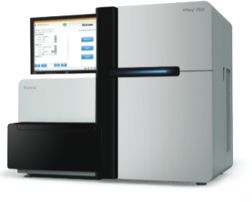


Resequencing switchgrass genomes
>950 genomes
~800 tetraploids (4x)
~150 octoploids (8x)
median coverage = ~45x
mapped against version 5 assembly
>46 million SNPs
~ 250 Tb data for BAM files alone!
Hoping to add another ~100 lines from MX
X_{ten} & Novaseq
sequencing
Jeremy Schmutz
Sujan Mamidi
HudsonAlpha and DOE JGI

Slide 18
Population Structure and Demographic History

Slide 19
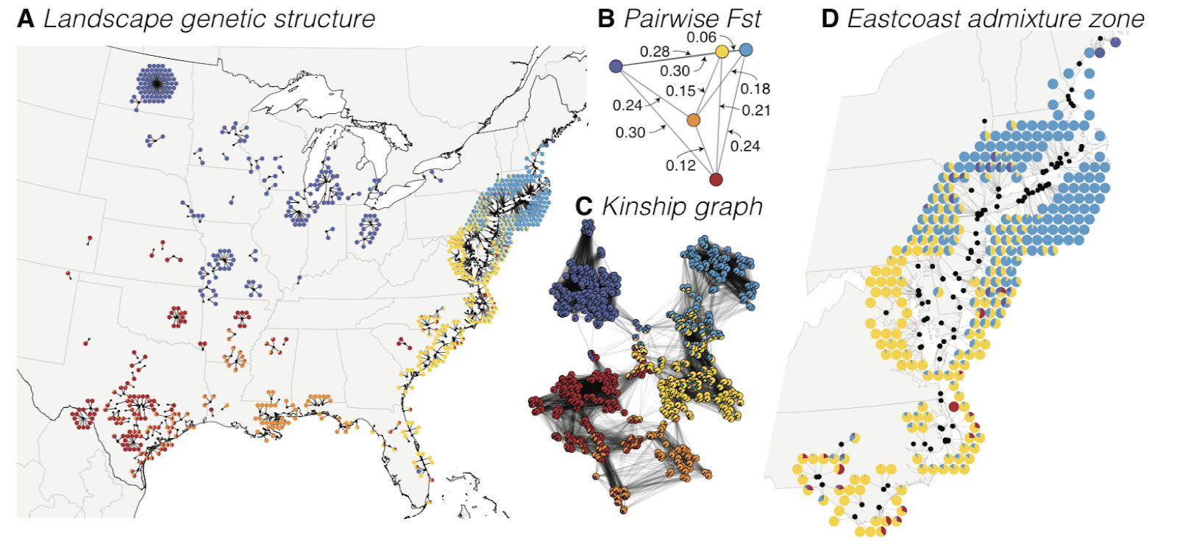
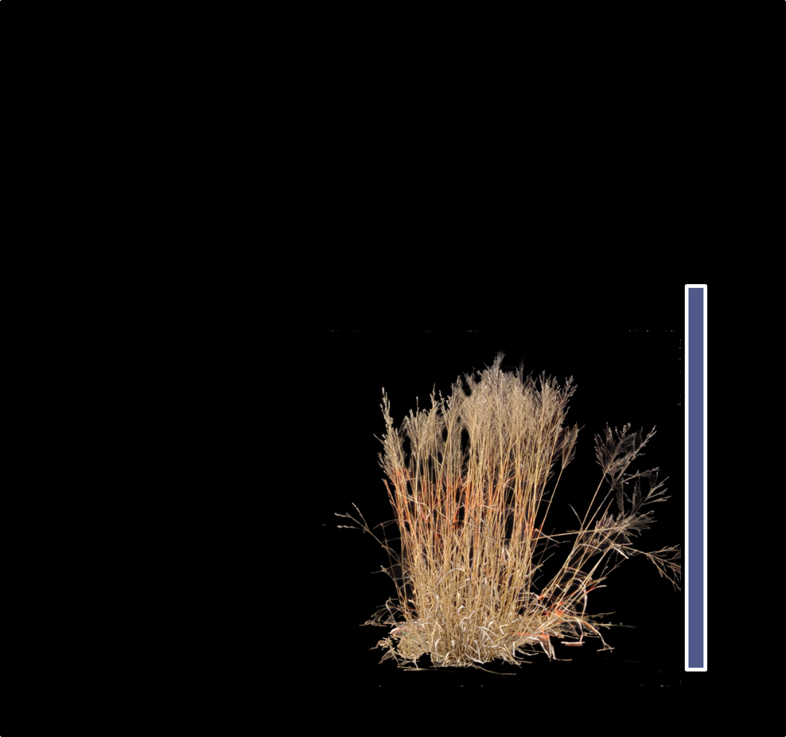
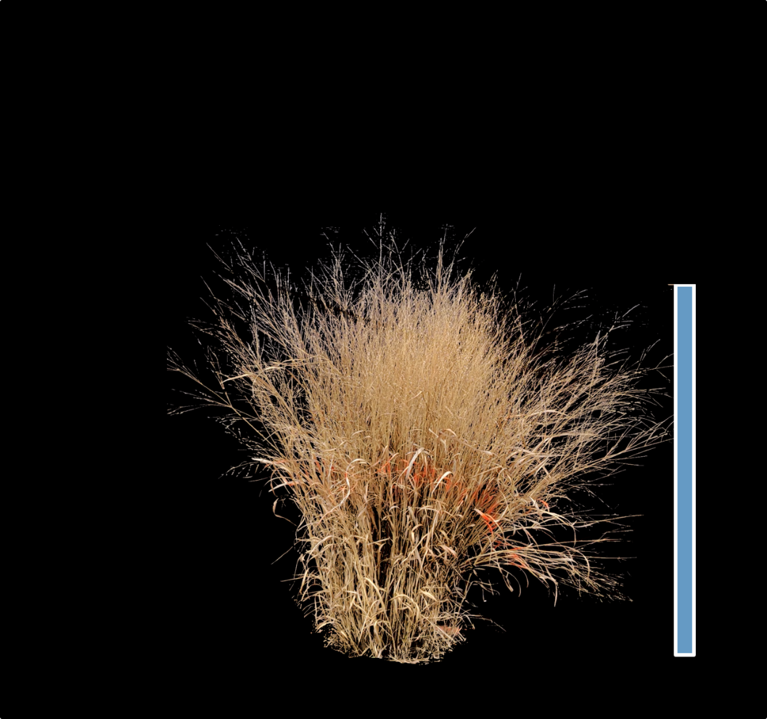
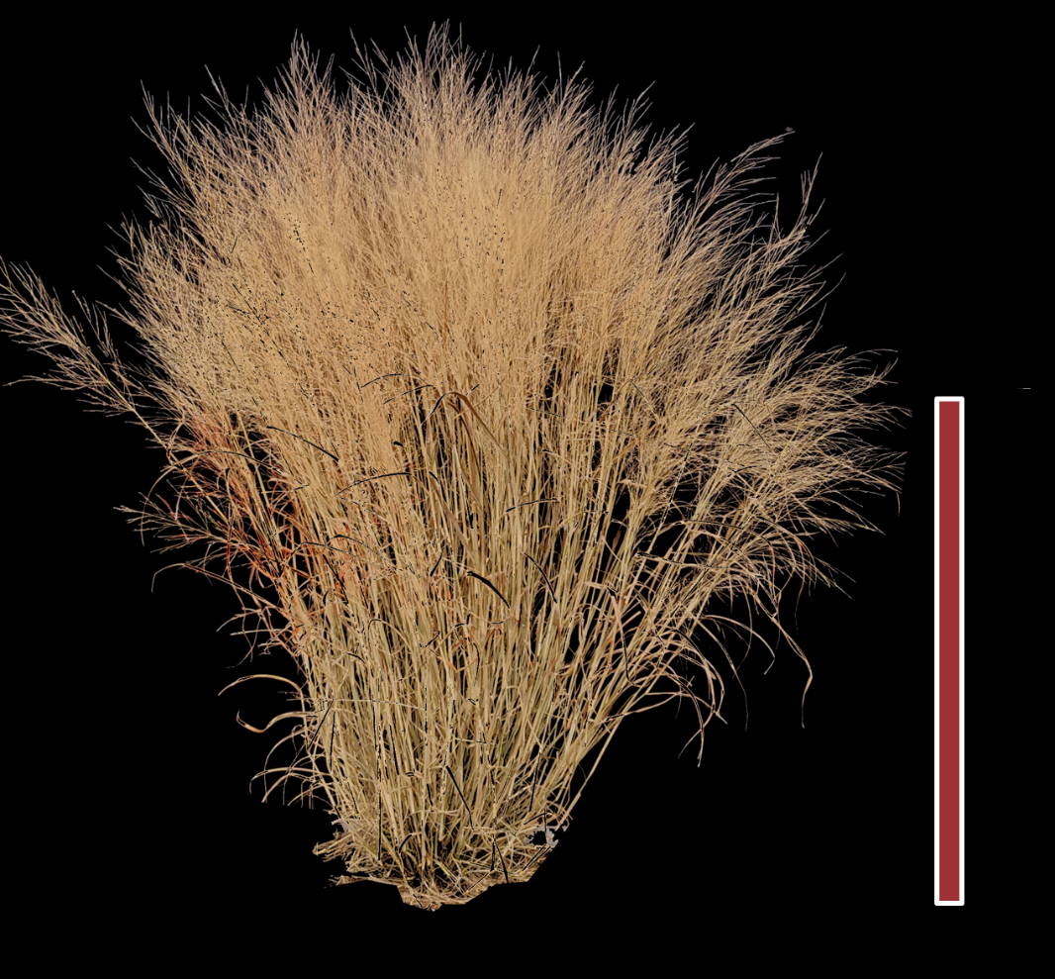
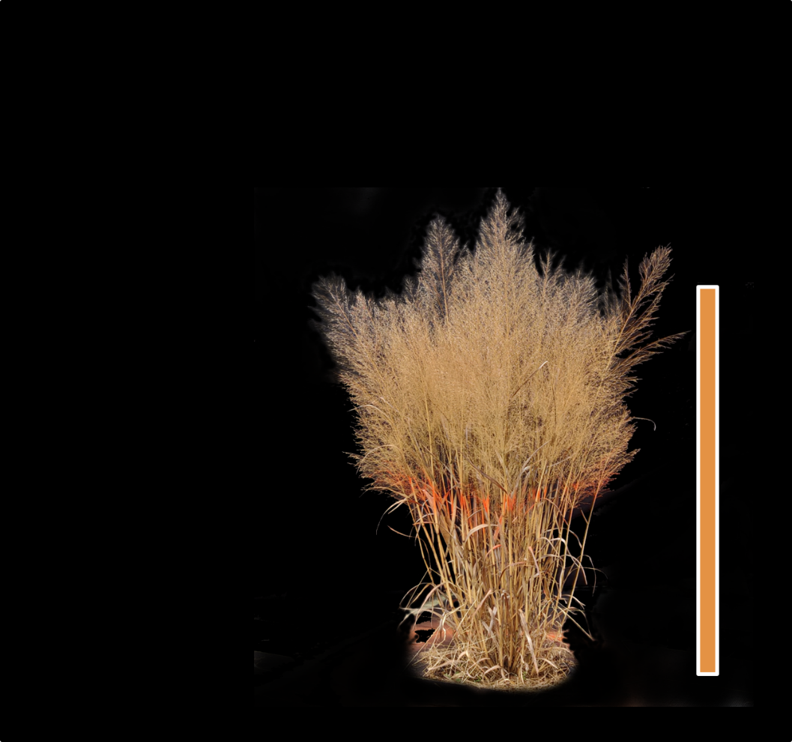
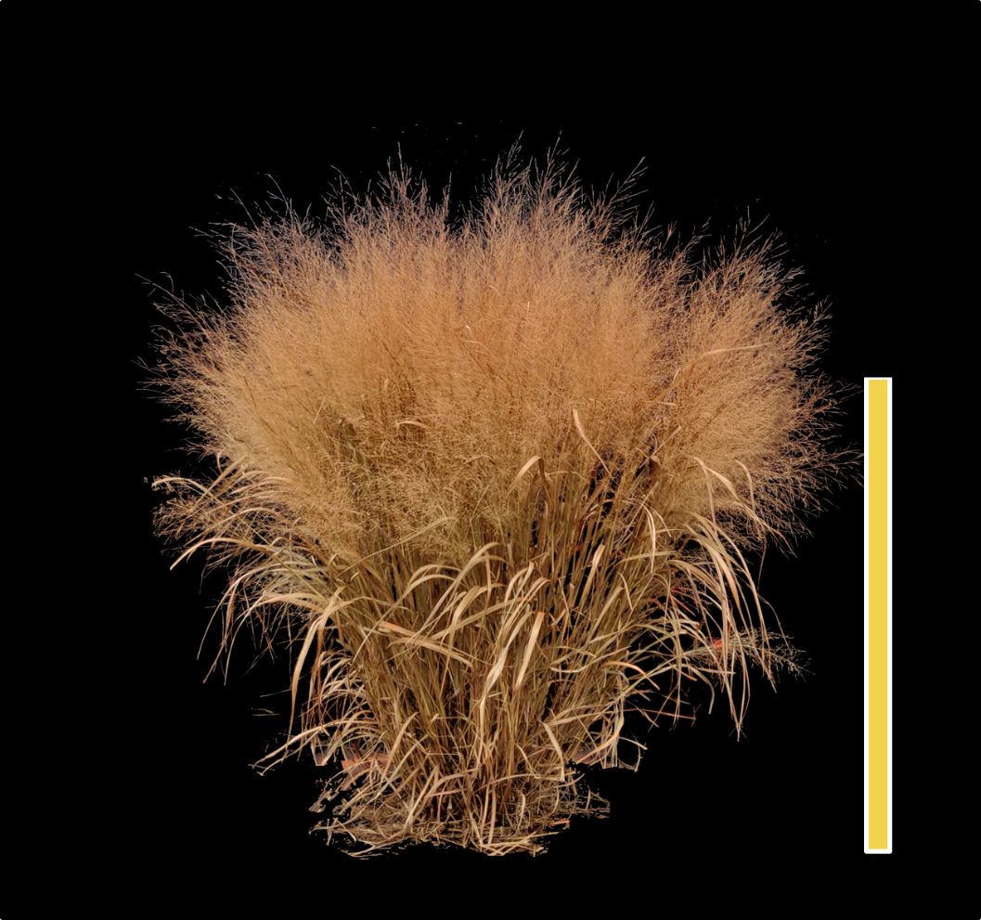

Slide 20
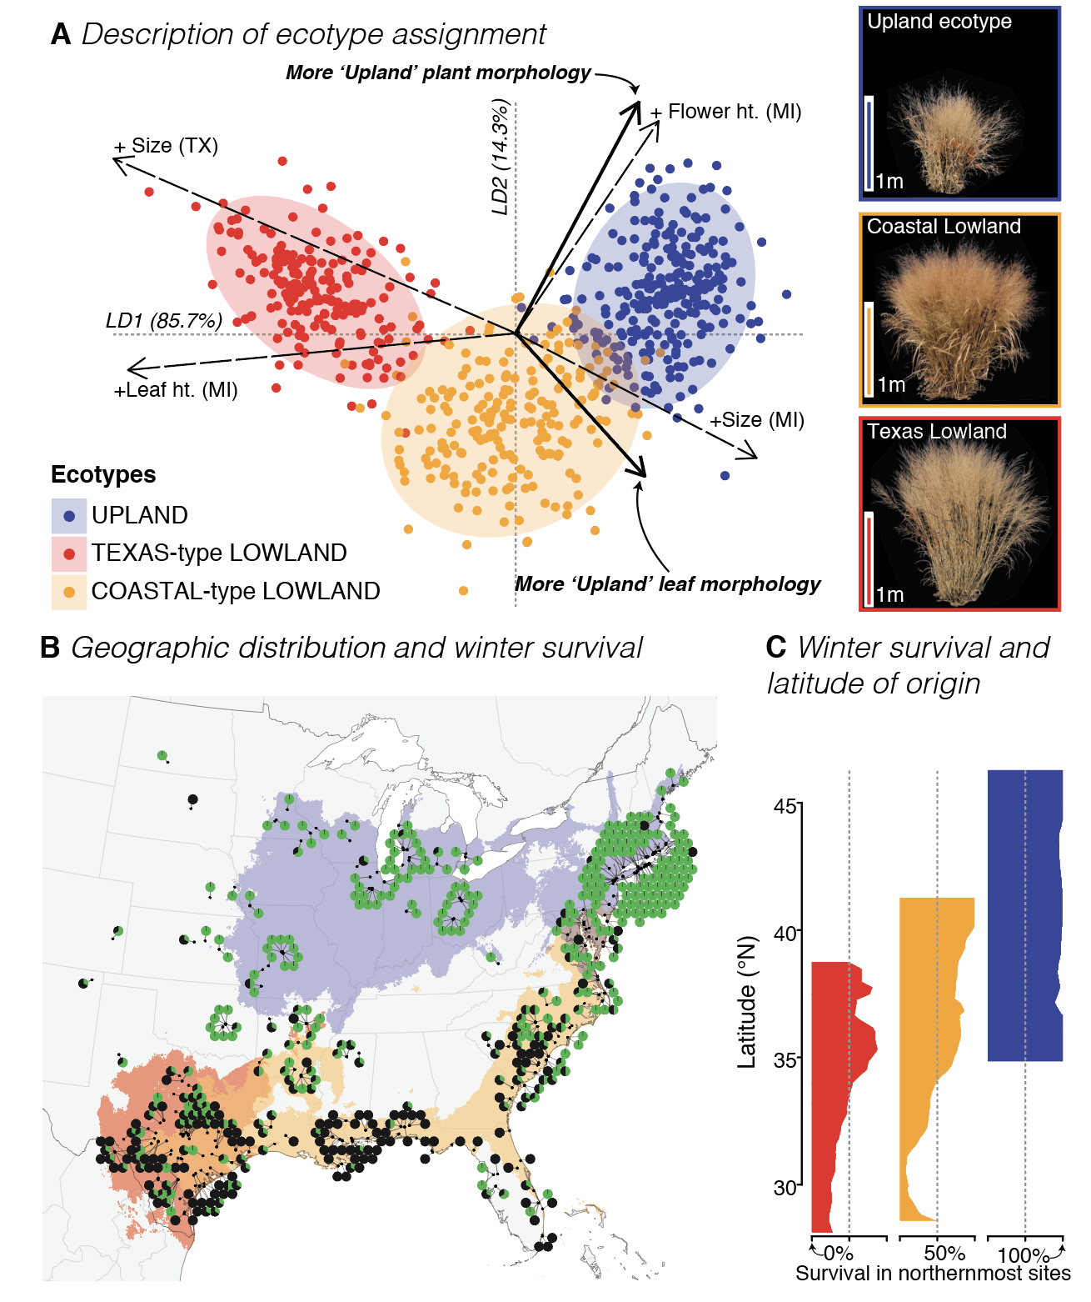

Slide 21
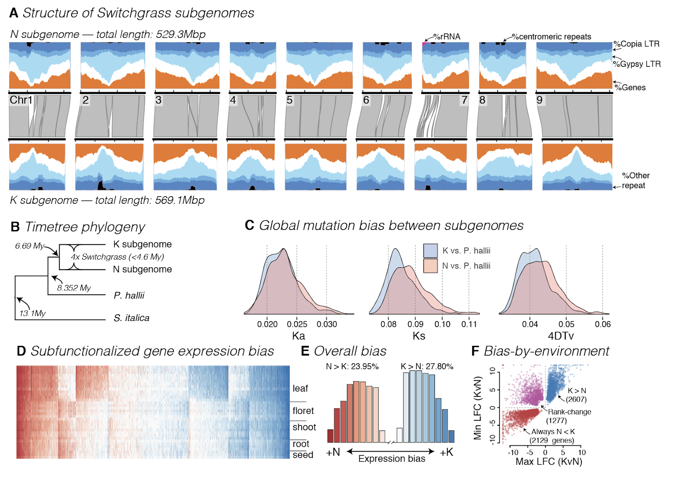

Slide 23
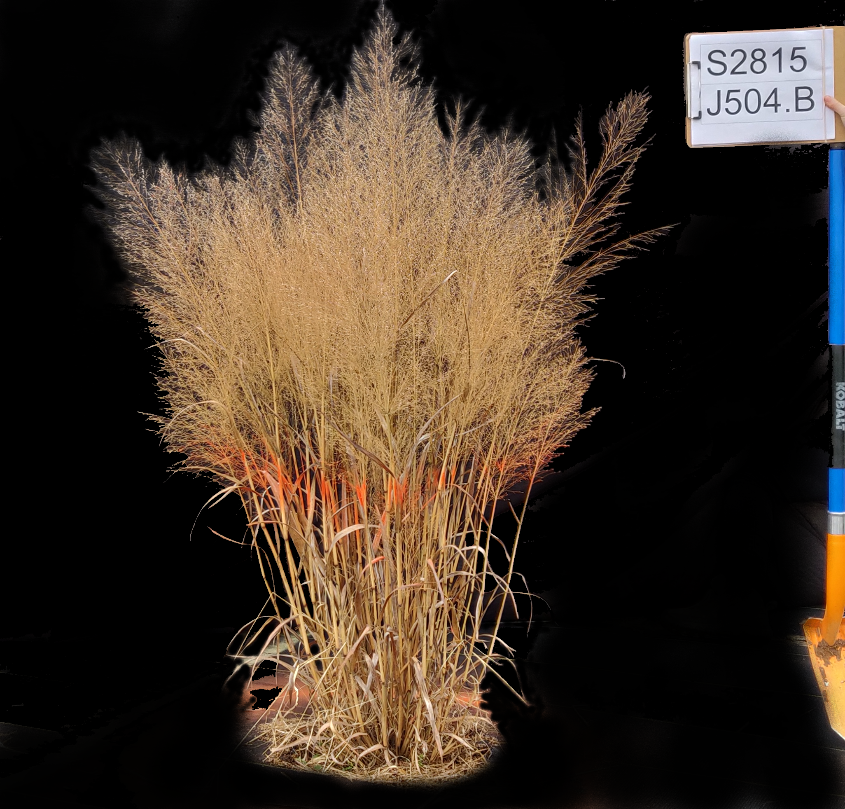

Slide 24
Identifying candidate genes
QTL mapping
GWAS mapping
Omic studies
Population Genomics
transgenic/gene editing experiments

Slide 25
What is bigsnpr?
An R package for the analysis of massive SNP arrays, primarily designed for human genetics.
Nice methods to control for population structure… PCA on LD clumped SNPs, testing for long-range LD.
FAST univariate association… on 21 million SNPs in < 2 minutes

Slide 26
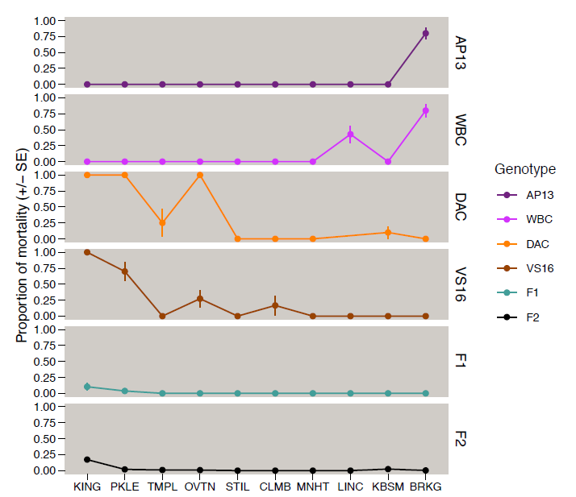
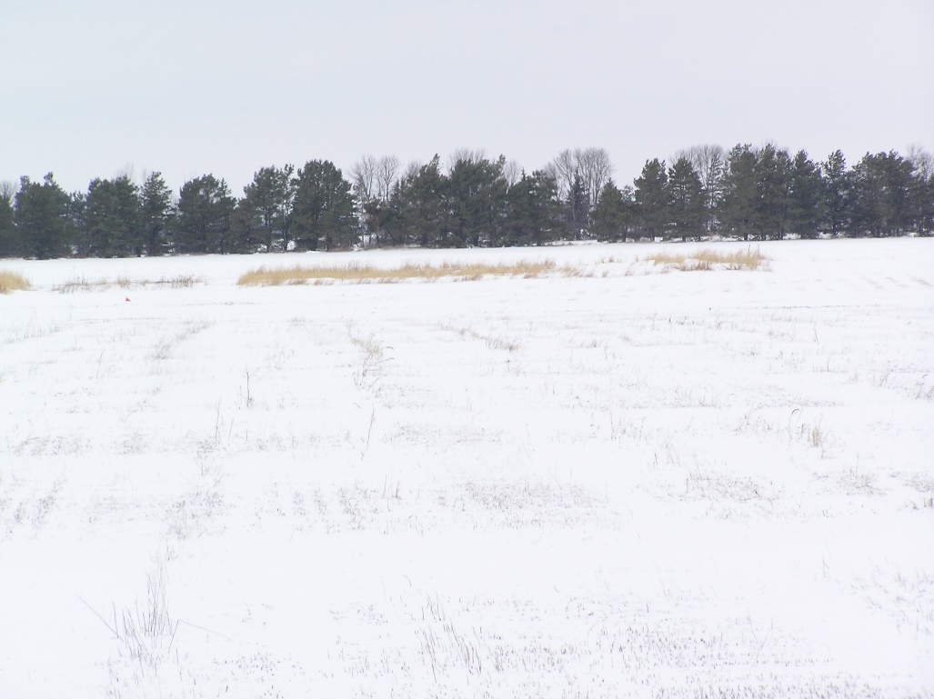
Winter 2018 was cold and we observed considerable winter kill in the north
Brooking SD,
11 degrees F on April 5^{t}h

Slide 27
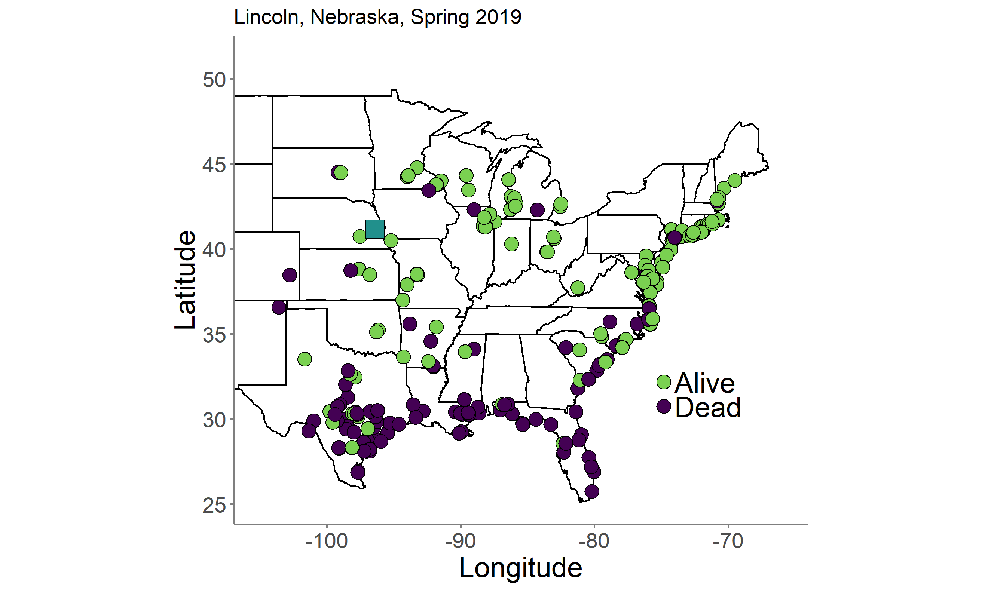
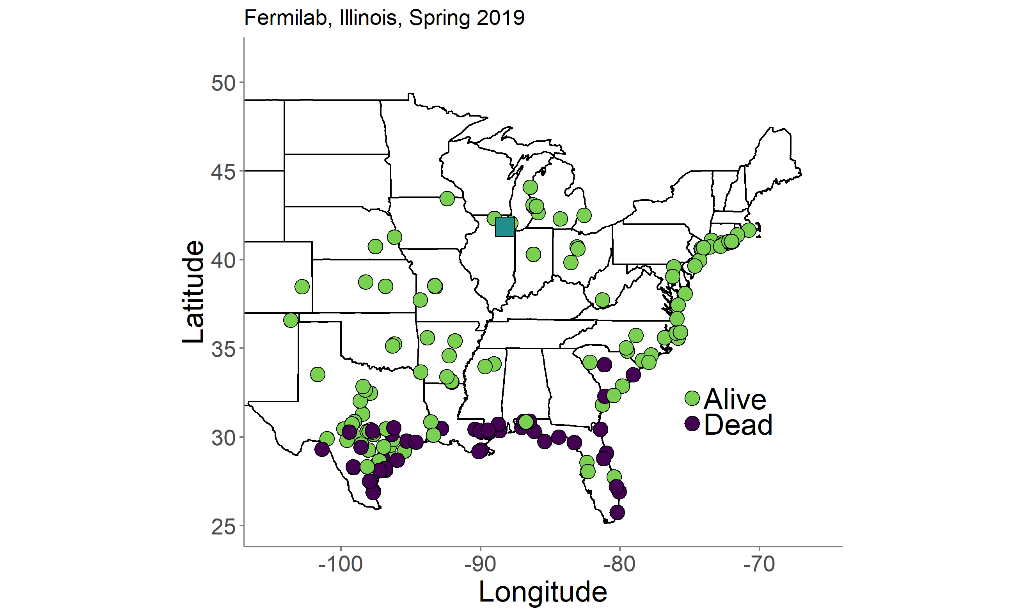
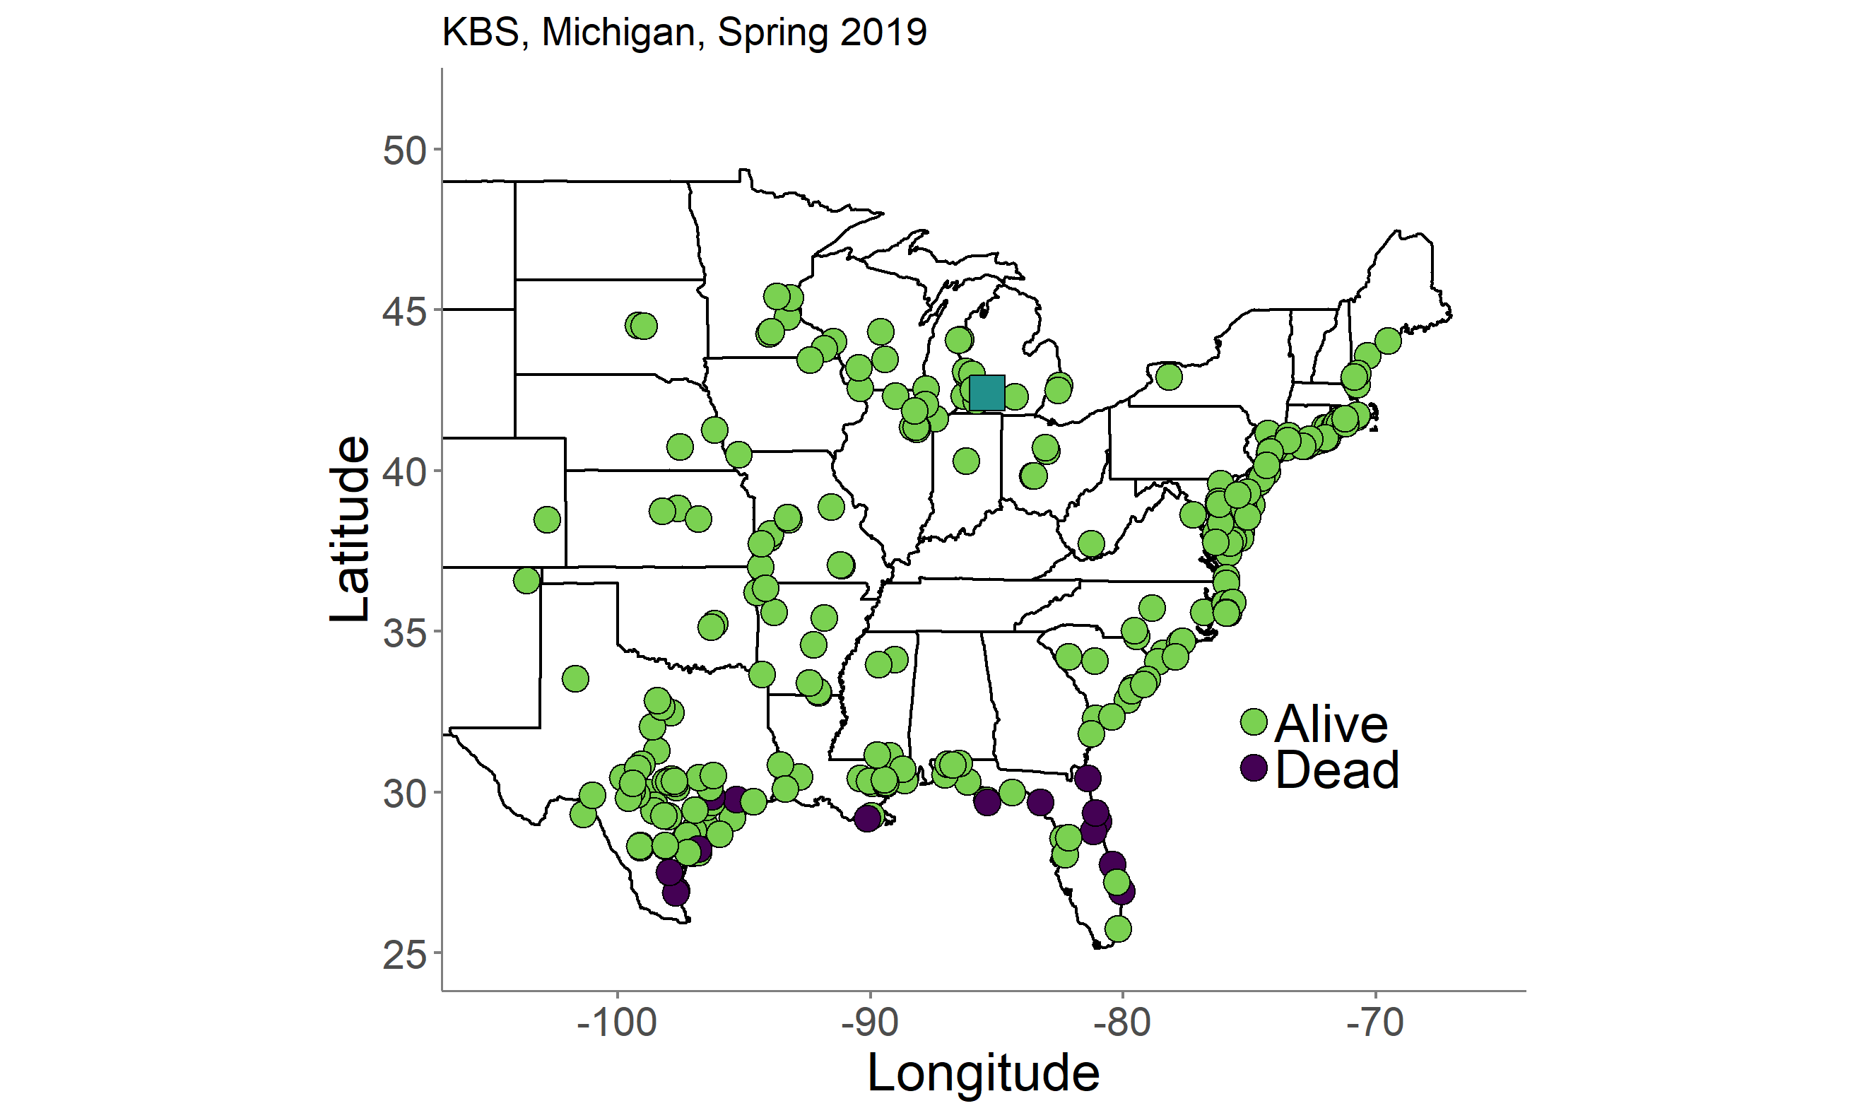
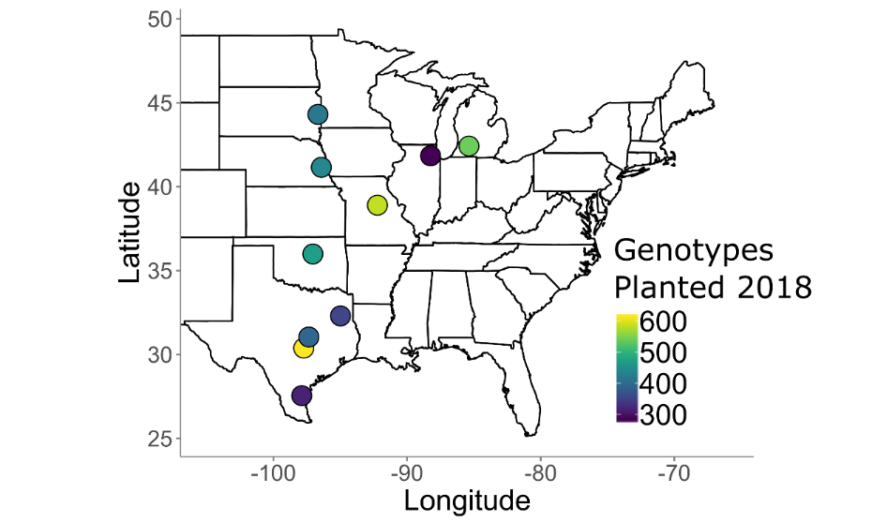
Considerably mortality in north

Slide 28
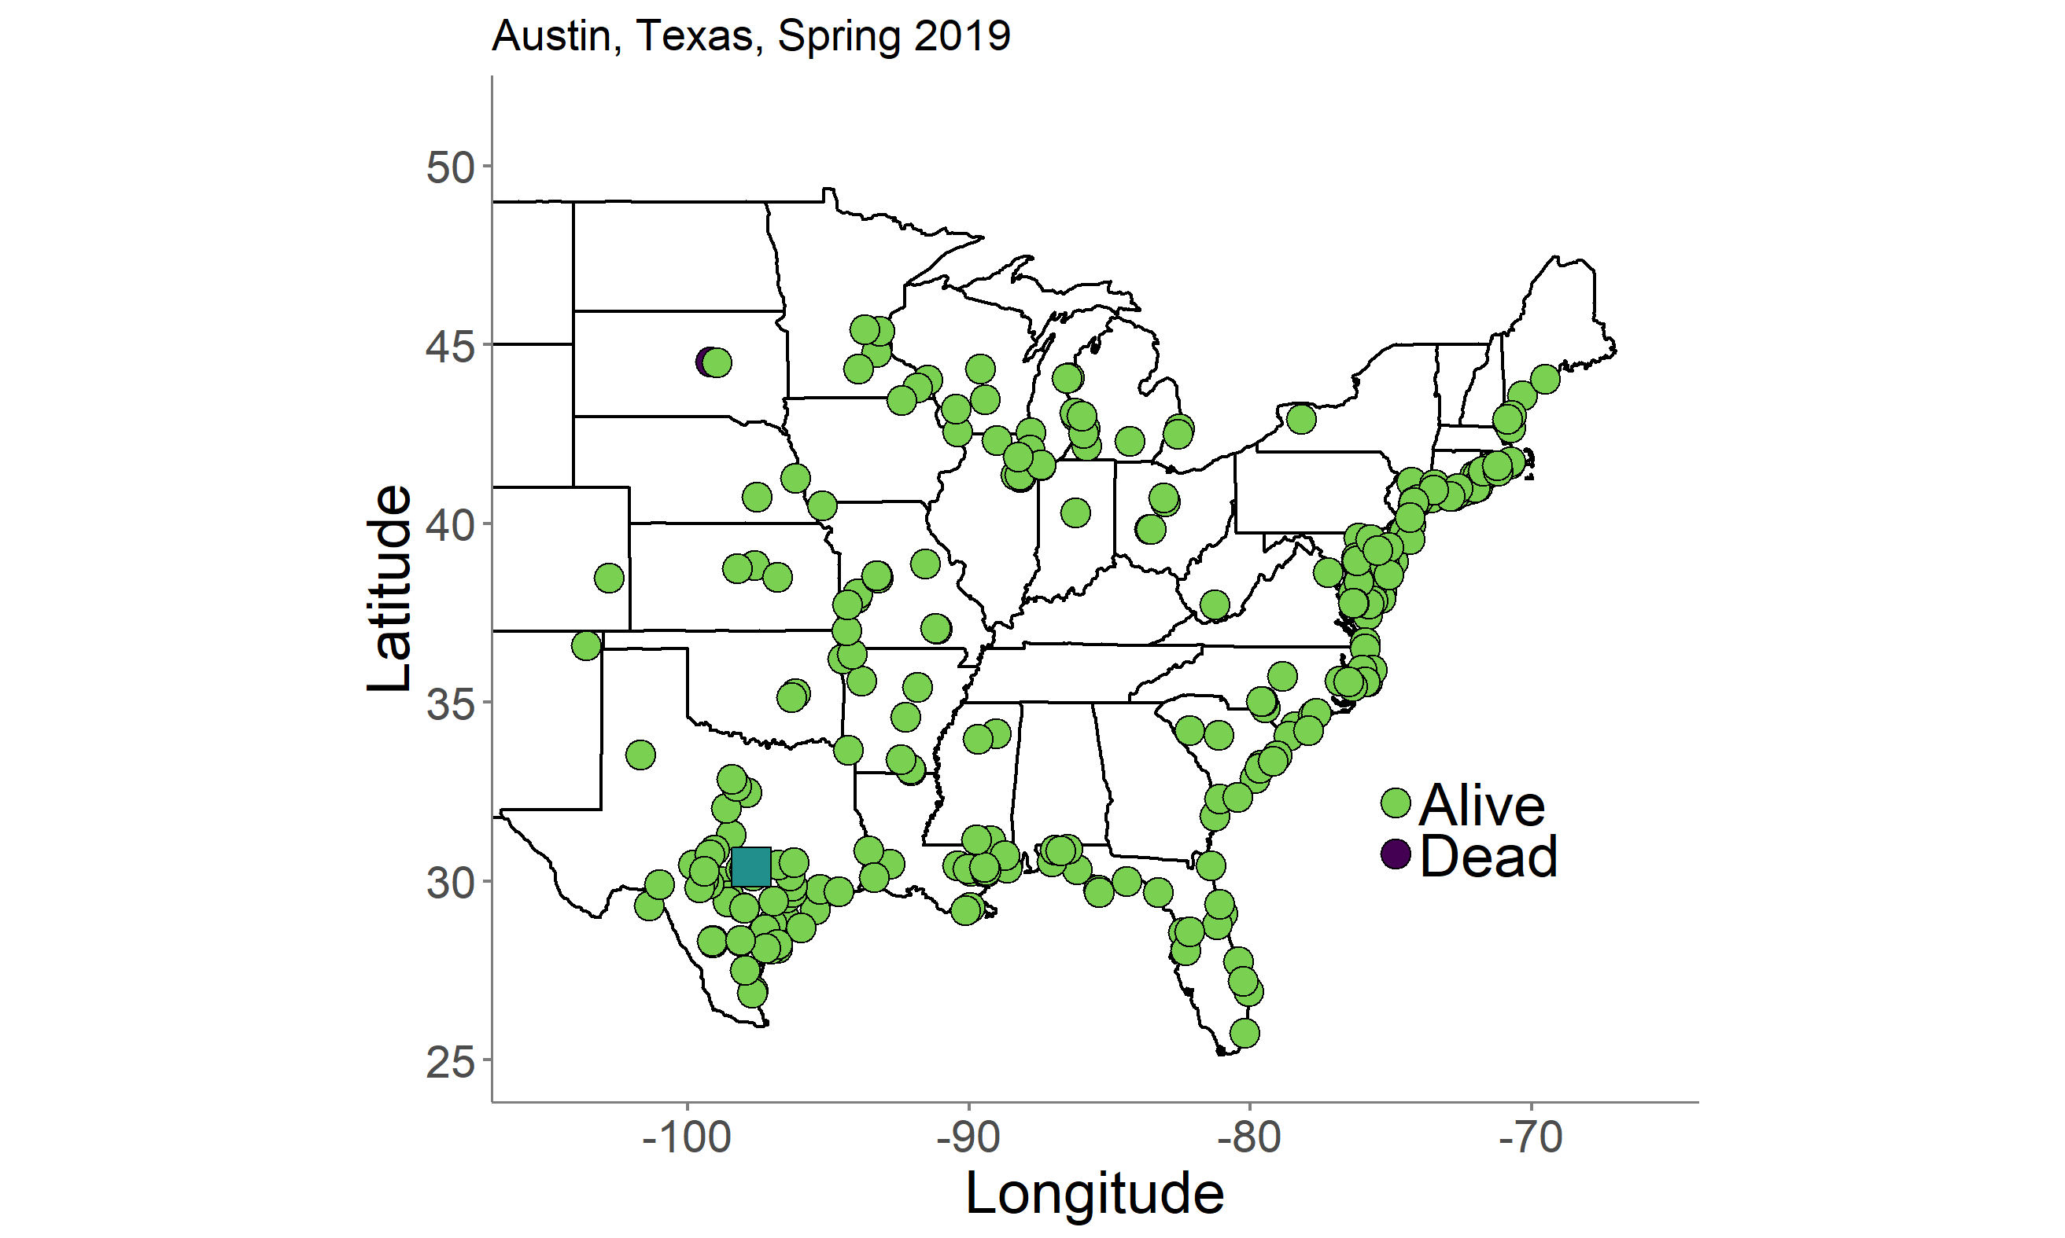
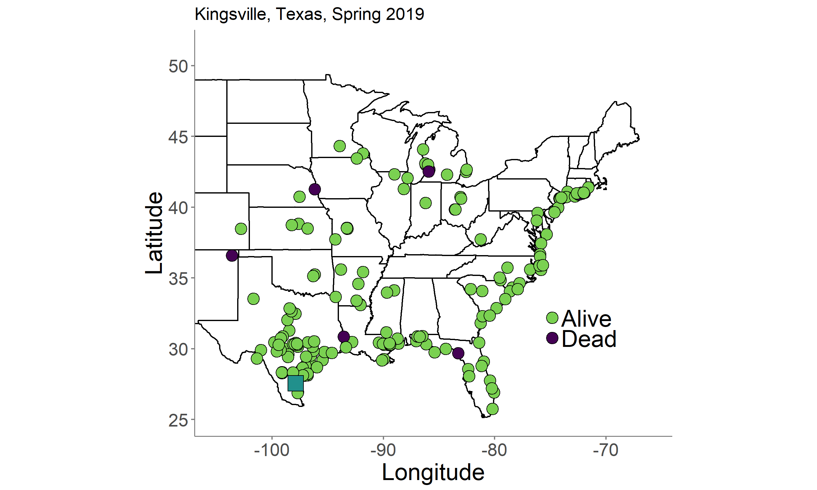
Good survivorship
in the south

Slide 29
Summary and Outlook
Climate may have been a strong driver of adaptation and genetic diversity in switchgrass – perhaps more important than isolation-by-distance within subpopulations. GEA analyses may be useful for generating candidate gene hypotheses.
Strong pattern of local adaptation with mortality of lowland ecotypes in the north and upland ecotypes in south. In general, southern lowlands and their hybrids have had a broader range of performance in the first 3 years of study.
Widespread QTL x E underlies local adaptation – site and year are both important. Conditional effects common - few tradeoff patterns have emerged in the hybrid progeny.
In terms of breeding, we may be able to select stable QTL or stack together conditionally beneficial QTL to minimize tradeoffs and improve general vigor and climate adaptation.

Slide 30
Summary
Strong pattern of local adaptation with significant mortality of lowlands in north and uplands in south. In general, southern lowlands have had a broader range of high biomass performance in the first 3 years of study. GEA analyses suggest climate associated with a good fraction of SNP diversity.
Widespread QTL x E – conditional effects common - few tradeoff patterns so far.
There is more to come: GWAS panel will expand genetic variance, adaptability, and opportunities for studying GxE
We hope this resource will be useful to the community and welcome collaborative efforts.

Slide 31
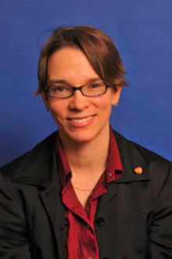




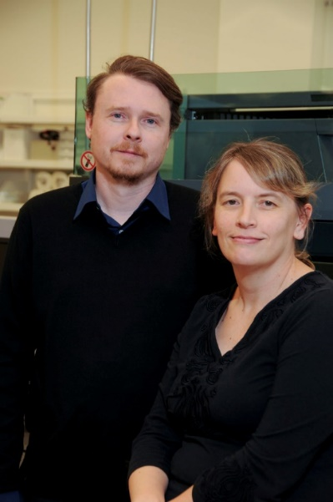

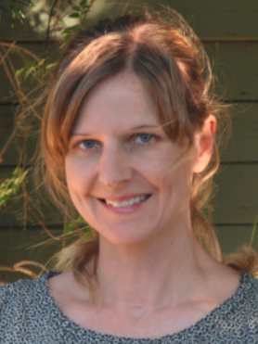

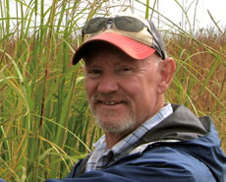

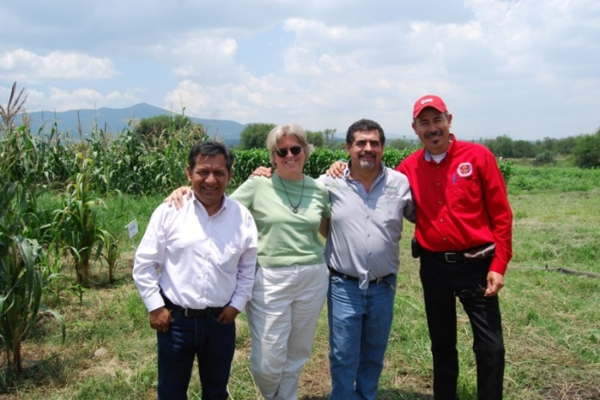

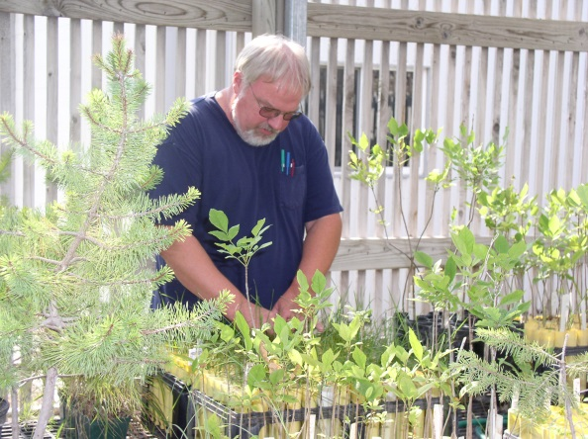



Slide 32



Collaborators
David Lowry (Michigan State University)
Felix Fritschi (Mizzou)
Phil Fay (USDA-ARS, Temple TX)
Jason Bonnette (UT Austin)
Laura Bartley (University of Oklahoma)
John Reilly (USDA-PML, Kingsville TX)
Yanqi Wu (OSU, Stillwater OK)
Monty Rouquette (TAMU-Overton, TX)
Rob Mitchell (USDA-ARS, Lincoln NB)
Arvid Boe (SDSU, Brookings SD)
Kyle Turner
Nathan Pfluger
Matt Donoghue
Chris Bourbois
Jonathan Colen
Sam Lutfy
Marissa Van Damme
Quin Hiers
Paige Overton
John Row
Joey Budi
Logan Simon
Jeremy Schmutz (JGI/HudsonAlpha)
Jerry Jenkins (HudsonAlpha)
Avinash Sreedasyam (HudsonAlpha)
Sujan Mamidi (HudsonAlpha)
John Lovell (HudsonAlpha)
Shiangqiang Shu (LBL)
Dan Rokhsar (DOE JGI)
Kerrie Barry (DOE JGI)
Funding
DOE Sustainability
JGI CSP
NSF PGRP
DOE Arpa-e

Slide 33




How good is V5?
P. hallii HAL
Chr01K
V4
4,828
contigs
N-Genome
C3 vs. C8, historical Panicoid duplication
V5
33
contigs
K-Genome

